Slide 1

RT KNITS · INNOVATION CHALLENGE
RT
Agentic AI-Powered CMMS
Kick-off & Onboarding · Mentor Session
RT Knits · Innovation Challenge
Notes:
Welcome the teams warmly. Frame the session: this is a kick-off, not a lecture — by the end you will know how maintenance works today, the data behind it, how to organise your team, and exactly what to submit next. 7 teams, one real factory, jury pitch on 25 July is the finish line.

Slide 2




TODAY'S SESSION
What we'll cover in this kick-off
1
2
The current system
The data foundation
How a request is raised, assigned, and closed today.
The schema behind it — entities, links, real sample data.
3
4
Organise your team
Your next step
Elect a leader and map roles to each member's strengths.
Build a proposal — your mentors validate before you build.
RT Knits · Innovation Challenge
Notes:
Walk the four parts quickly so people have a map. Parts 1 and 2 give shared context (same for every team); parts 3 and 4 are about what YOUR team does next. Keep it to a minute.

Slide 3
1
PART 1
The Current System
How a 24/7 factory keeps its machines running — today.
RT Knits · Innovation Challenge
Notes:
Transition slide. For the next few minutes everyone learns the same thing — exactly how a maintenance job flows today, end to end. You cannot improve what you do not understand.

Slide 4
2
PART 2
The Data Foundation
The relational backbone — your single source of truth.
RT Knits · Innovation Challenge
Notes:
Transition slide. The system runs on data. We show the entities, how they relate, and real sample rows. A clean data model is what makes the AI agent possible — foundation, not afterthought.

Slide 5
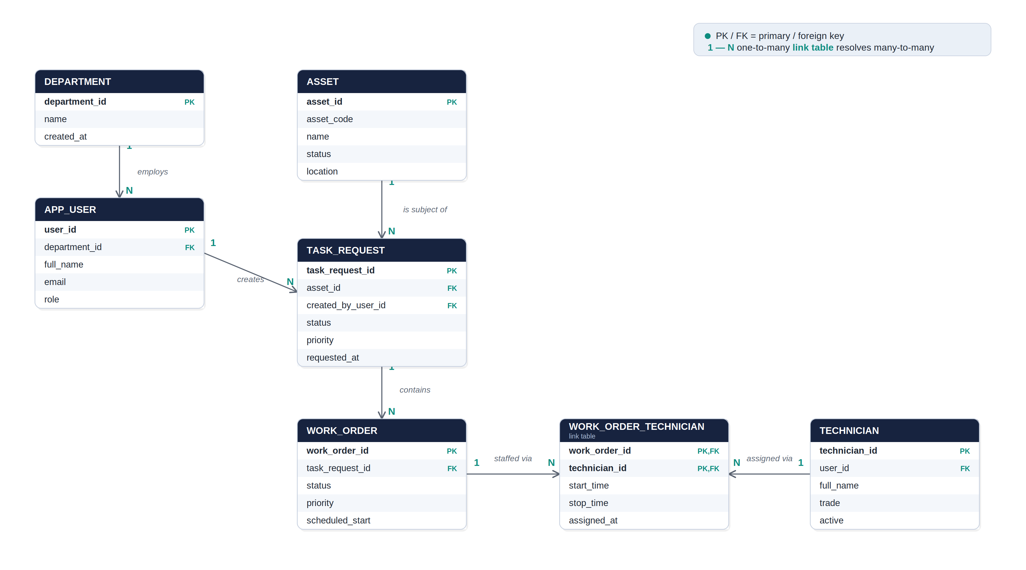
Entity-relationship diagram
Dashed in the schema (not shown): a technician may optionally map to one user account via technician.user_id.
Notes:
Read it top-to-bottom: a department employs users; a user creates a task request against one asset; a task request contains many work orders; each work order is staffed by technicians through the link table, which also records start/stop times. The arrow points from the 'one' side to the 'many' side.

Slide 6
Relationships at a glance
Relationship | Type | Implemented by
Department → User | One-to-many | FK department_id on app_user
User → Task request | One-to-many | FK created_by_user_id on task_request
Asset → Task request | One-to-many | FK asset_id on task_request
Task request → Work order | One-to-many | FK task_request_id on work_order
Work order ↔ Technician | Many-to-many | Junction work_order_technician
User ↔ Technician | Zero/one ↔ zero/one | Nullable unique FK user_id on technician
Every relationship is enforced with a foreign key; the only many-to-many gets its own link table.
Notes:
One-to-many relationships are just a foreign-key column on the 'many' side. The work order to technician link is the only true many-to-many, so it needs a separate table. The user-technician link is optional on both sides.

Slide 7
3
PART 3
Organise Your Team
Pick a leader, then play to every member's strengths.
RT Knits · Innovation Challenge
Notes:
Transition slide. Shift from context to action. The next two slides are about how YOUR team sets itself up to win — leadership first, then dividing work by strength.

Slide 8


FIRST MOVE
Elect a team leader
Before any design work, agree on one person to hold the team together.
Single point of contact
Keeps the cadence
The mentors talk to one person — questions and updates flow through the leader.
Sets meeting times, tracks tasks, makes sure nothing stalls before deadlines.
Owns the submission
Breaks ties
Responsible for assembling and sending the proposal on time.
When the team is split, the leader makes the call so you keep moving.
RT Knits · Innovation Challenge
Notes:
First concrete action: elect a leader today. Frame it positively — a coordinator, not a boss (a nice echo of the challenge itself). One point of contact for mentors, keeps cadence, owns the submission, breaks ties. Prevents the most common failure: a team that drifts because no one is steering.

Slide 9
4
PART 4
Your Next Step
Build a proposal — we validate before you build.
RT Knits · Innovation Challenge
Notes:
Transition slide. This is what they leave to go do. Build anticipation: a clear next deliverable and a mentor gate before building starts.

Slide 10

BEFORE THE NEXT SESSION
Submit your proposal — then we validate
What your proposal should cover
The validation gate
1
Solution design architecture, agent behaviour, user flows
You submit
2
Decision logic how it prioritises, plans, and where humans step in
the proposal lands with your mentors
↓
3
Data model what's captured at each step, and how it's reused
We review & validate
we check the thinking and flag gaps
4
Impact analysis expected gains vs. today — time, uptime, effort
↓
Green light to build
approved teams start building
Validating first means you never spend a week building the wrong thing.
RT Knits · Innovation Challenge
16
Notes:
The call to action. Before the next session each team submits a proposal covering the five items on the left (prototype optional but a strong one helps). Then the validation gate: we review, flag gaps, give a green light. Emphasise WHY we validate first — it stops a team building the wrong thing for a week.

